Slide 1

PhonePe Transaction Insights
BY-Ria SINGH

Slide 2


Problem Statement
With the increasing reliance on digital payment systems like PhonePe, understanding the dynamics of transactions, user engagement, and insurance-related data is crucial for improving services and targeting users effectively. This project aims to analyze and visualize aggregated values of payment categories, create maps for total values at state and district levels, and identify top-performing states, districts, and pin codes.

Slide 3



BUSINESS USE CASES
Decoding Transaction Dynamics
Device Dominance and User Engagement Analysis
Insurance Penetration and Growth Potential Analysis
Transaction Analysis for Market Expansion
User Engagement and Growth Strategy

Slide 4

Decoding Transaction Dynamics

Slide 5
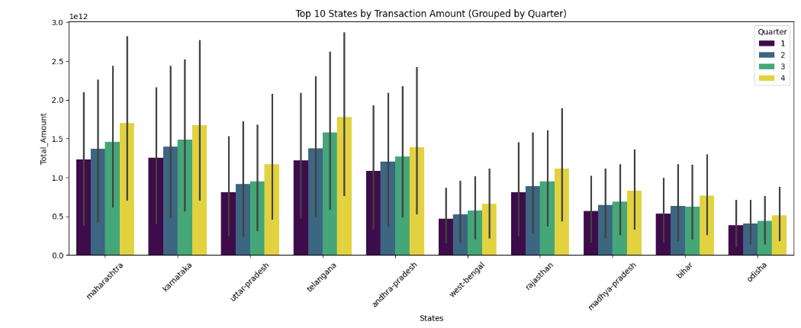
Maharashtra and Karnataka consistently lead in quarterly transaction volumes, with all top 10 states showing stable trends across quarters.

Slide 6
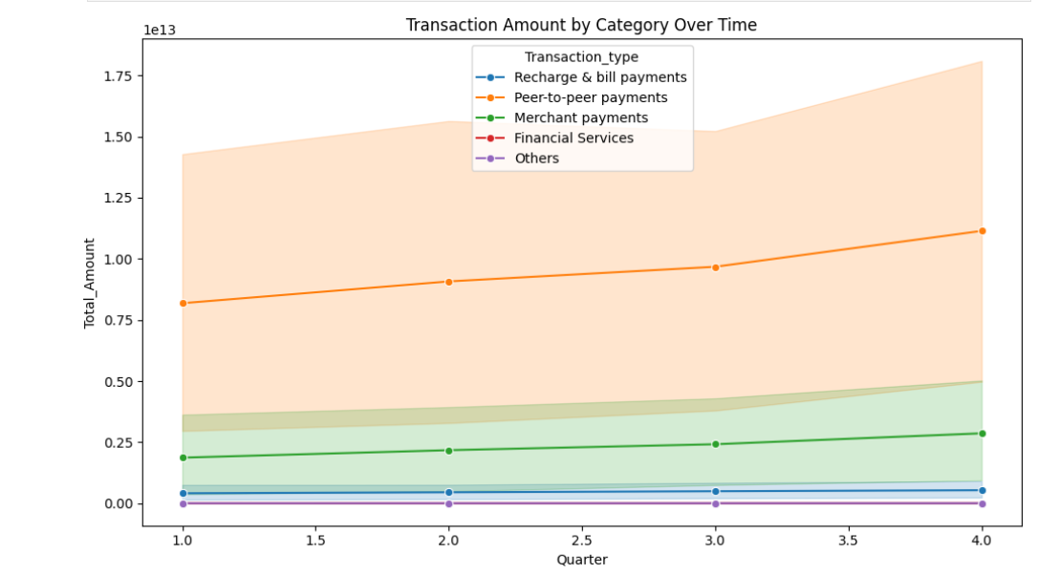
Peer-to-peer payments dominate transaction categories, crossing ₹17 trillion by Q4, while Merchant Payments show steady growth.

Slide 7

Device Dominance and User Engagement Analysis

Slide 8
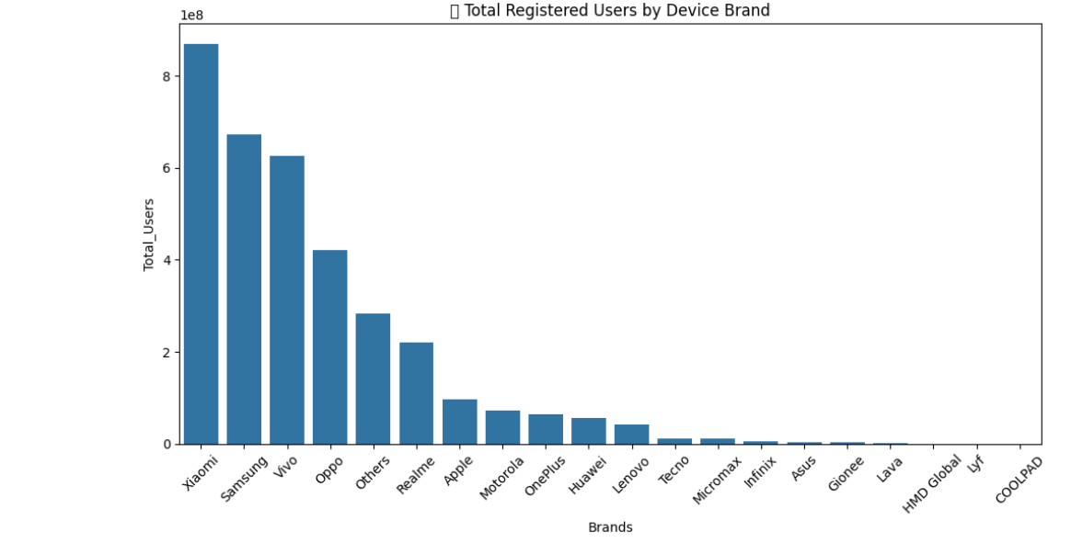
Xiaomi leads the market with the highest number of registered users, followed by Samsung, Vivo, and Oppo.

Slide 9
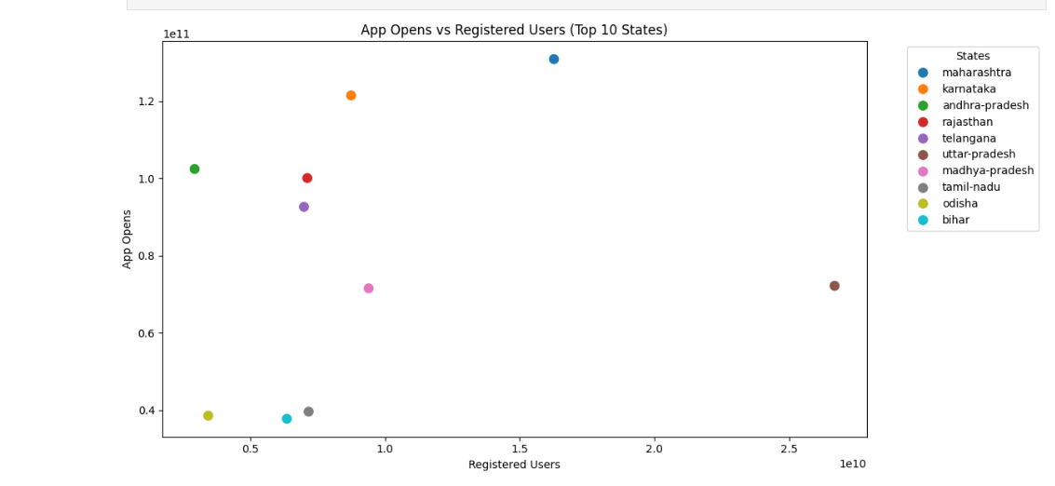
Maharashtra stands out with the highest number of registered users, while Karnataka shows exceptional app engagement despite having fewer registrations

Slide 10

Insurance Penetration and Growth Potential Analysis

Slide 11
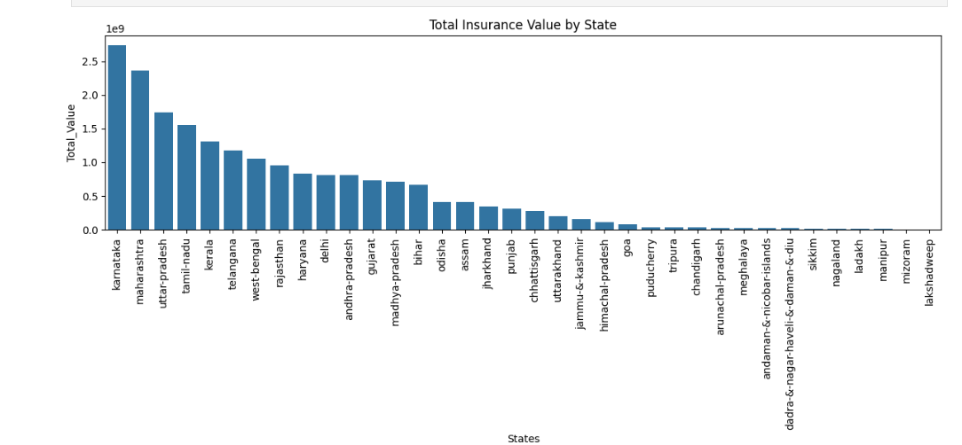
Karnataka tops total insurance value among Indian states, followed by Maharashtra and Uttar Pradesh.

Slide 12
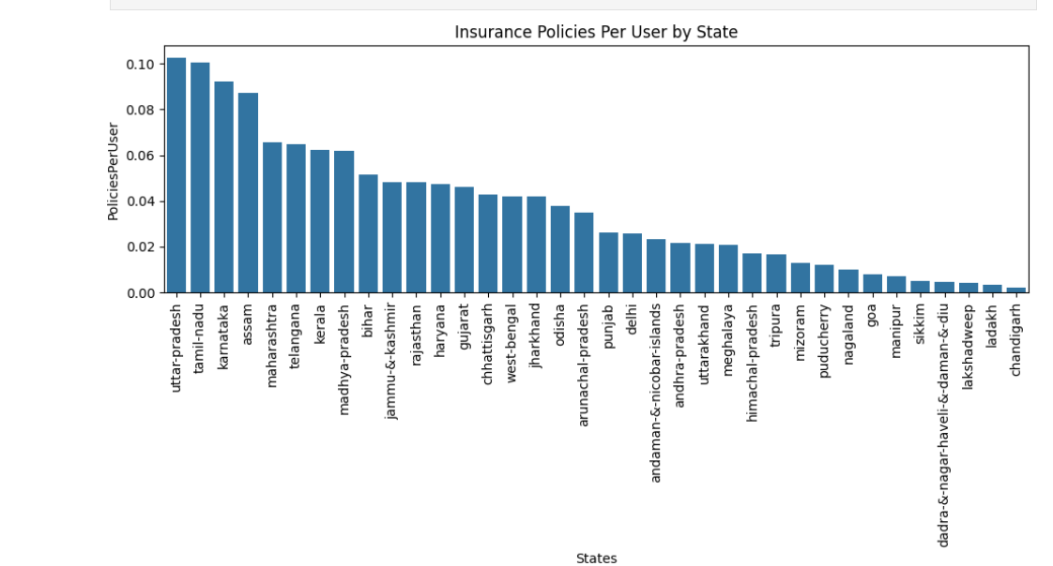
Uttar Pradesh leads in average insurance policies per user, suggesting deeper financial inclusion, while Chandigarh ranks lowest

Slide 13

Transaction Analysis for Market Expansion

Slide 14
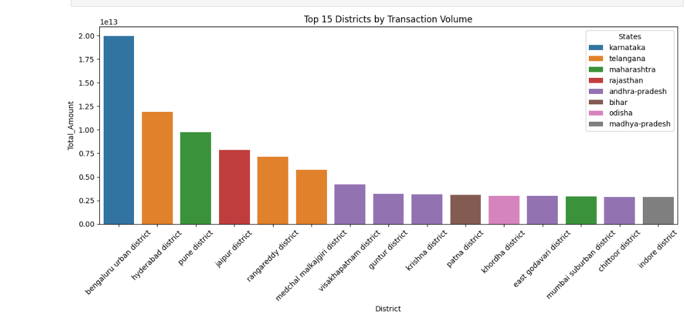
Bengaluru Urban and Hyderabad lead transaction volumes, followed by Pune and Jaipur, reflecting strong digital activity in urban and tech-driven districts.

Slide 15
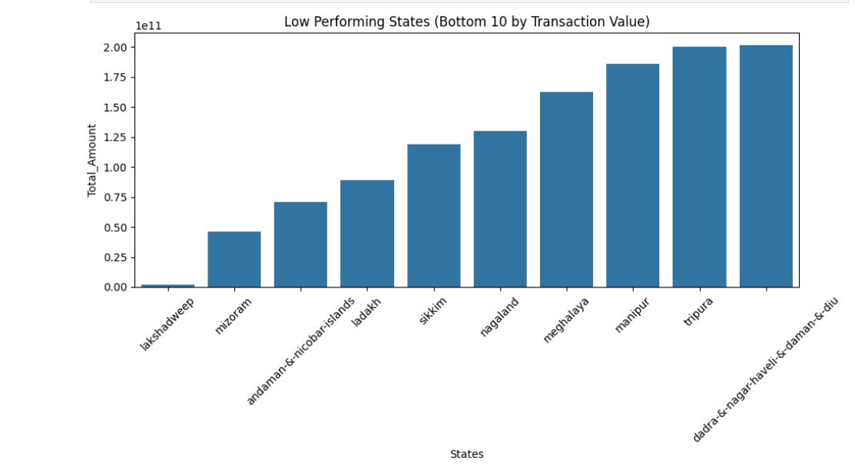
Lakshadweep records the lowest transaction among all states followed by Mizoram

Slide 16

User Engagement and Growth Strategy

Slide 17
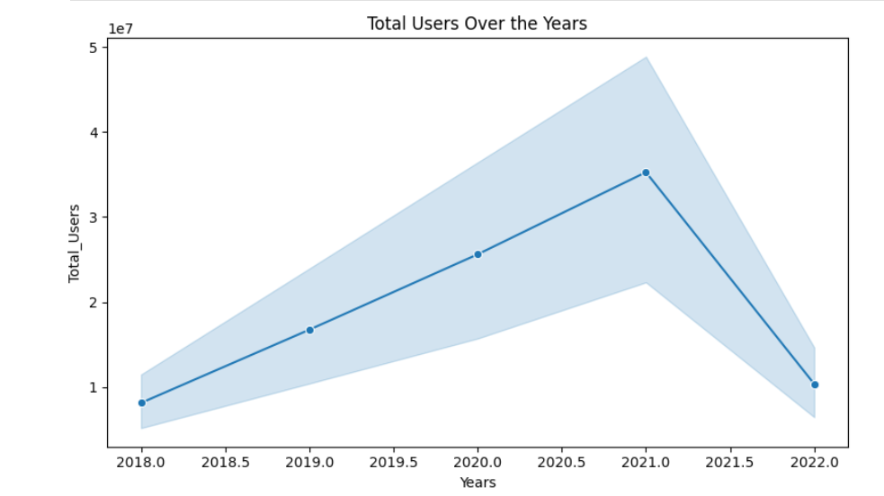
User growth surged from 2018 to 2021, peaking above 45 million, but saw a sharp decline in 2022

Slide 18
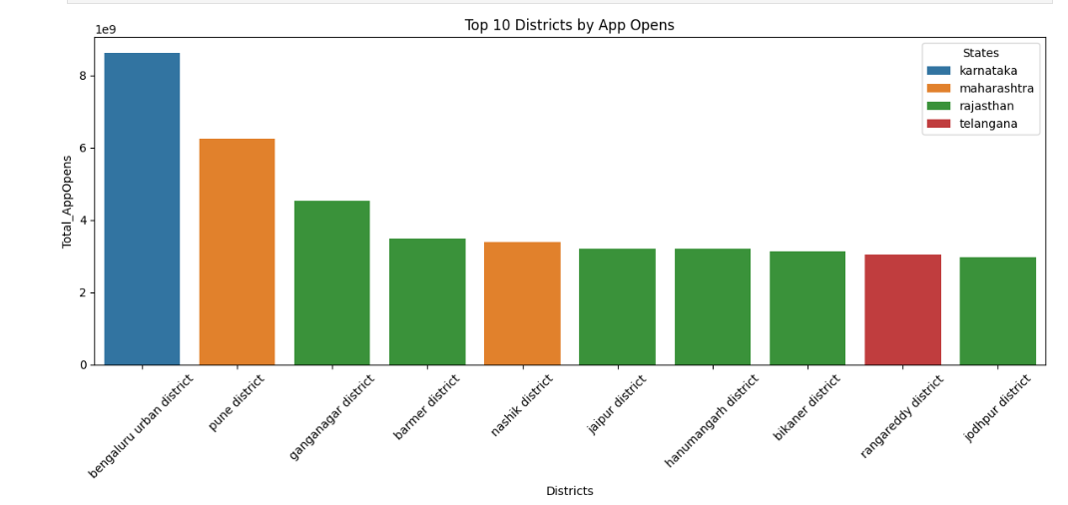
Bengaluru Urban leads app engagement by a wide margin, followed by Pune and several districts from Rajasthan like Ganganagar, Barmer, and Jaipur.

Slide 19
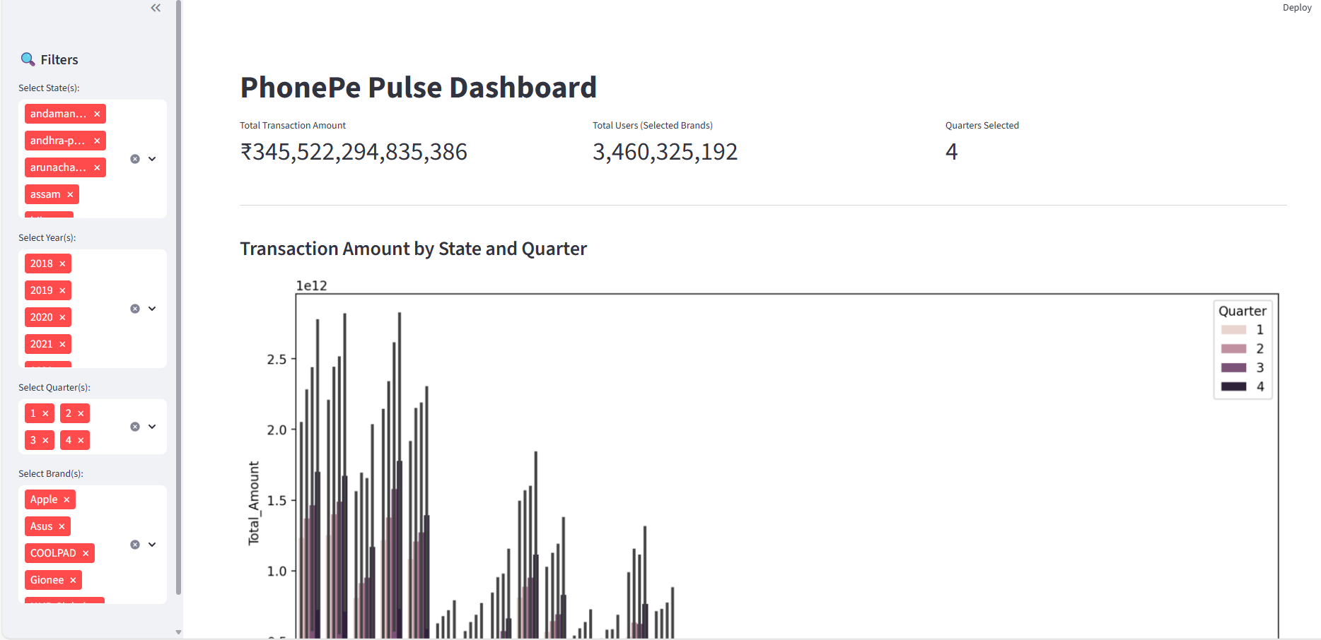
STREAMLIT DASHBOARD

Slide 20
Thank you

